Slide 1
Data Analysis

Slide 2
Data Profiling
The data profiling tools provide new and intuitive ways to clean, transform, and understand data in Power Query Editor. They include:
Column quality
Column distribution
Column profile
The column quality feature labels values in rows in five categories:
Valid, shown in green.
Error, shown in red.
Empty, shown in dark grey.
Unknown, shown in dashed green. Indicates when there are errors in a column, the quality of the remaining data is unknown.
Unexpected error, shown in dashed red.

Slide 3
Data Lineage
Power BI has several artifact types, such as dashboards, reports, datasets, and dataflows.
Many datasets and dataflows connect to external data sources such as SQL Server, and to external datasets in other workspaces.
When a dataset is external to a workspace you own, it may be in a workspace owned by someone in IT or another analyst.
External data sources and datasets make it harder to know where the data is coming from, ultimately. For complex projects and for simpler ones, we introduce lineage view.

Slide 4
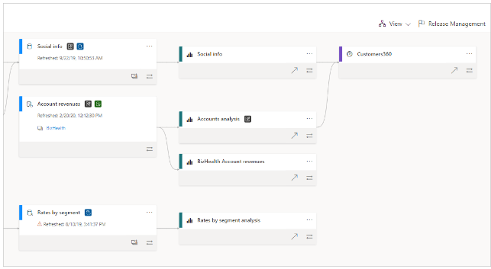
Data Lineage Overview
In lineage view, you see the lineage relationships between all the artifacts in a workspace, and all its external dependencies.
It shows connections between all workspace artifacts, including connections to dataflows, both upstream and downstream.

Slide 5
Data Quality
Data quality measures the condition of data, relying on factors such as how useful it is to the specific purpose, completeness, accuracy, timeliness (e.g., is it up to date?), consistency, validity, and uniqueness.
Data quality analysts are responsible for conducting data quality assessments, which involve assessing and interpreting every quality data metric. Then, the analyst creates an aggregate score reflecting the data’s overall quality and gives the organization a percentage rating that shows how accurate the data is.
To put the definition in more direct terms, data quality indicates how good the data is and how useful it is for the task at hand. But the term also refers to planning, implementing, and controlling the activities that apply the needed quality management practices and techniques required to ensure the data is actionable and valuable to the data consumers.

Slide 6
Data Quality Dimensions
Accuracy
The data must conform to actual, real-world scenarios and reflect real-world objects and events. Analysts should use verifiable sources to confirm the measure of accuracy, determined by how close the values jibe with the verified correct information sources.
Completeness
Completeness measures the data's ability to deliver all the mandatory values that are available successfully.
Consistency
Data consistency describes the data’s uniformity as it moves across applications and networks and when it comes from multiple sources. Consistency also means that the same datasets stored in different locations should be the same and not conflict. Note that consistent data can still be wrong.
Timeliness
Timely data is information that is readily available whenever it’s needed. This dimension also covers keeping the data current; data should undergo real-time updates to ensure that it is always available and accessible.
Uniqueness
Uniqueness means that no duplications or redundant information are overlapping across all the datasets. No record in the dataset exists multiple times. Analysts use data cleansing and deduplication to help address a low uniqueness score.
Validity
Data must be collected according to the organization’s defined business rules and parameters. The information should also conform to the correct, accepted formats, and all dataset values should fall within the proper range.

Slide 7
Data Quality Best Practices
Make sure that top-level management is involved. Data analysts can resolve many data quality issues through cross-departmental participation.
Include data quality activity management as part of your data governance framework. The framework sets data policies and data standards, the required roles and offers a business glossary.
Each data quality issue raised must begin with a root cause analysis. If you don’t address the root cause of a data issue, the problem will inevitably appear again. Don’t just address the symptoms of the disease; you need to cure the disease itself.
Maintain a data quality issue log. Each issue needs an entry, complete with information regarding the assigned data owner, the involved data steward, the issue’s impact, the final resolution, and the timing of any necessary proceedings.
Fill data owner and data steward roles from your company’s business side and fill data custodian roles from either business or IT whenever possible and makes the most sense.
Use examples of data quality disasters to raise awareness about the importance of data quality. However, while anecdotes are great for illustrative purposes, you should rely on fact-based impact and risk analysis to justify your solutions and their required funding.

Slide 8
Data Flow
A dataflow is a collection of tables that are created and managed in workspaces in the Power BI service.
A table is a set of columns that are used to store data, much like a table within a database. You can add and edit tables in your dataflow, and manage data refresh schedules, directly from the workspace in which your dataflow was created.
Creating a dataflow by using linked tables enables you to reference an existing table, defined in another dataflow, in a read-only fashion. The following list describes some of the reasons you might choose this approach:
If you want to reuse a table across multiple dataflows, such as a date table or a static lookup table, you should create a table once and then reference it across the other dataflows.
If you want to avoid creating multiple refreshes to a data source, it's better to use linked tables to store the data and act as a cache. Doing so allows every subsequent consumer to use that table, reducing the load to the underlying data source.
If you need to perform a merge between two tables.

Slide 9
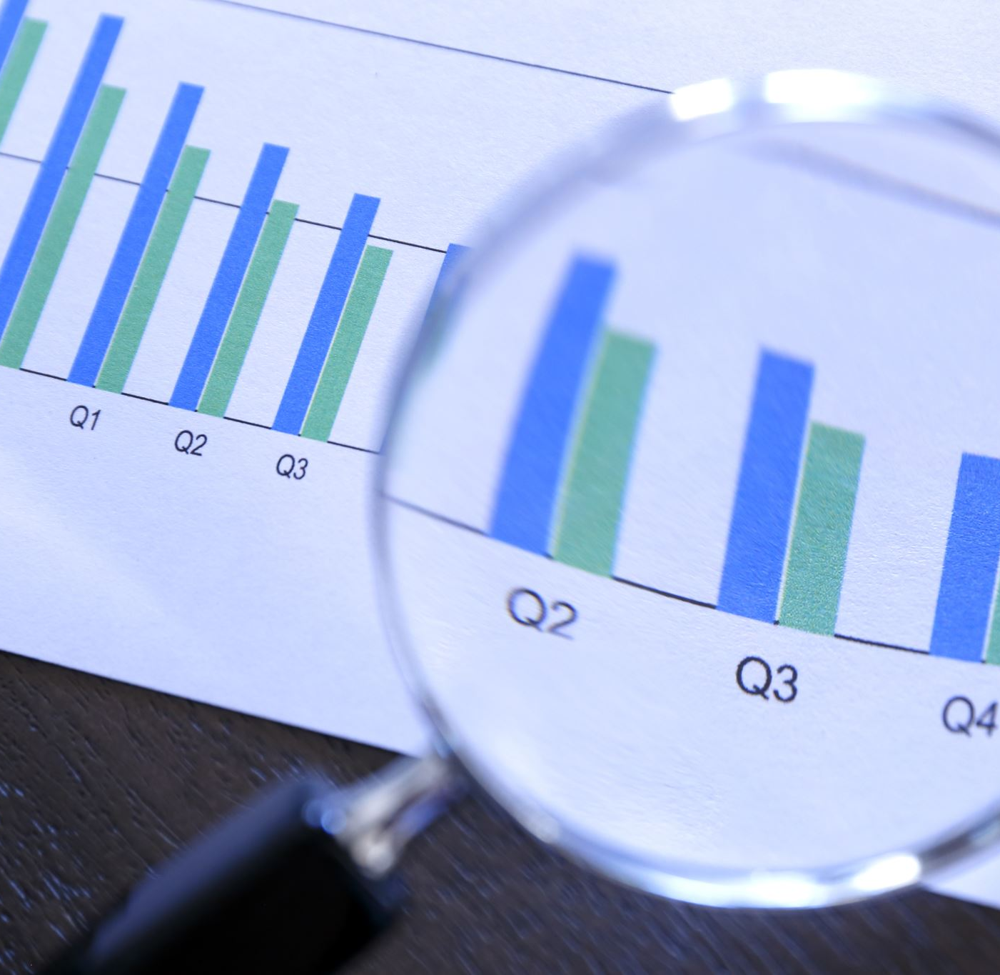
Data Analysis with Alteryx

Slide 10
Alteryx Overview
Alteryx is a cloud based ETL visualization tool for data analytics and data blending platform.
Data blending, enrichment and advanced analytical tools specifically caters for business and data analysis.
Self service data analysis
Prep, blend and analyse all data to deploy and share deeper insights in hours.

Slide 11
Benefits of Alteryx
It can generate reports, schedule reports and do auto email reports.
This is a drag-drop tool which’s easy to use and customize.
Alteryx can speed up the time to obtain business answers / data insights.
Data blending and descriptive, creating consolidated data sets, joins, unions, summarize, all basic and advanced data manipulation tasks.

Slide 12
Cons of Alteryx
There’s place for improvement for data visualization
Requires better integration with data platforms.
The techniques included for ML are not advanced.
Predictive analytics is not used by everyone, potential can be unmasked only data science use cases.
Even when it’s already includes some AI modes, area can be improved.

Slide 13
Why Alteryx
Single Analytic Experience
Drag and drop workflow
Advanced data modelling
Spatial analysis
Visual competence
Sharing

Slide 14
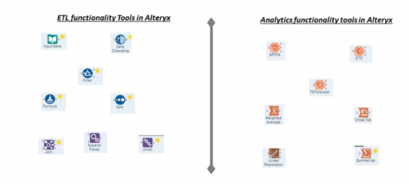
Why Alteryx
Alteryx is one stop shop, provide solutions for ETL, visualization data/statistical analysis

Slide 15
Alteryx Features
Alteryx allows data scientists to bring their own programming language to Alteryx – R, Python.
The codeless feature and speed of processing are unique, super intuitive to use , easy to master.
Alteryx does a great job for allowing more beginner analysts.

Slide 16
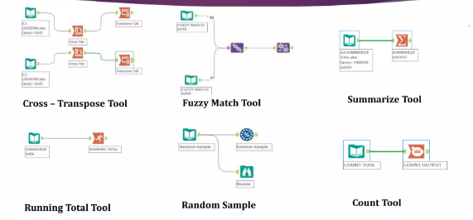
ETL Transformation

Slide 17
Tools Description
Cross – Tab – Pivot the orientation of the data stream so that the vertical fields are on the horizontal axis, summarized here specified.
Transpose Tool – Pivot the orientation of the data stream so that horizontal fields on the vertical axis.
Fuzzy Match – Identify non-identical duplicates in a data stream.
Summarize Tool – Summarize data by grouping, summing, counting, spatial processing , string concatenation

Slide 18
Tools Description
Running Total –Calculate a cumulative sum per record in a data stream.
Random Sample – Generate a random number / % of records passing to the data stream.

Slide 19
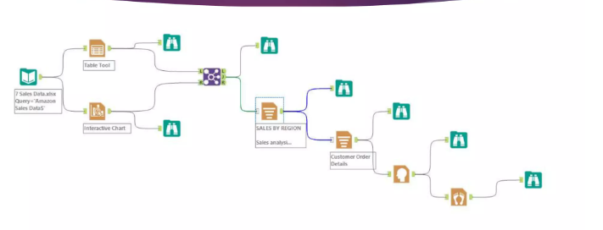
Alteryx Reporting

Slide 20
Tools Description
Table – Create a data table for output via the Render tool.
Charting – Create a chart (Area, column, Bar, Line, Pie etc.)
Report Header – add a header to report for output via a Render tool.
Report Footer – Add a footer to report for output via Render tool.

Slide 21
Tools Description
Report Text – Add the customize text for output via the Render tool.
Layout – Arrange two or more reporting snippets horizontally or vertically for output via outline Render tool.

Slide 22
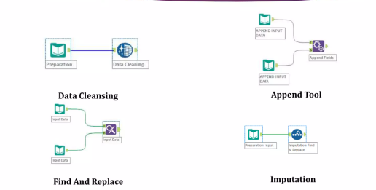
Data Cleansing Transformation

Slide 23
Tools Description
Data Cleansing – The data cleansing tool performs basic tool cleansing operations such as replacing null values, removing punctuations, modifying capitalization.
Append fields – Append the fields from a source input to every record of a target input. Each record of the target input will be duplicated for every record in the source input.
Find and replace – Search for data in one field from one data stream and replace with a specified field from a different stream. Similar to Excel VLOOKUP.
Imputation – Update specific values in numeric data field with another selected value. Useful for replacing NULL() values.

Slide 24
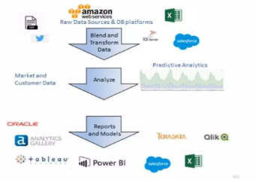
Alteryx Capabilities

